Slide 1
Building Intelligent Applications with Microsoft Graph
Tiago Costa - tiago.costa@outlook.com
Consultant, Trainer, Author and Speaker

Slide 2



Tiago Costa
Independent Contractor
MVP – Office Server and Services
MCT – Microsoft Certified Trainer and MCT RL – Regional Lead
IT Consultant, Trainer, Author and Speaker
MCT since 2006
tiago.costa@outlook.com | www.tiagocosta.eu
Follow me @tiagocostapt

Slide 3
“If having a coffee in the morning doesn’t wake you up, try to delete a table in production instead”
unknome developer

Slide 4
Agenda
Introduction to the Microsoft Graph
Getting started
SDKs and Code Samples
Resources

Slide 5
Slides and Demos
https://github.com/tiagocostapt/Presentations

Slide 6
Introduction to the Microsoft Graph

Slide 7
Developer Vision
Focus on User experience and their data.
We should bring user data and user experience into our applications.
Microsoft Office has over 1.2 billion users worldwide.
Office 365 numbers are huge with over 100 million monthly active subscribers.

Slide 8

Office 365 Developer momentum
"The most strategic developer surface area for us is Office 365“ - Satya Nadella

Slide 9

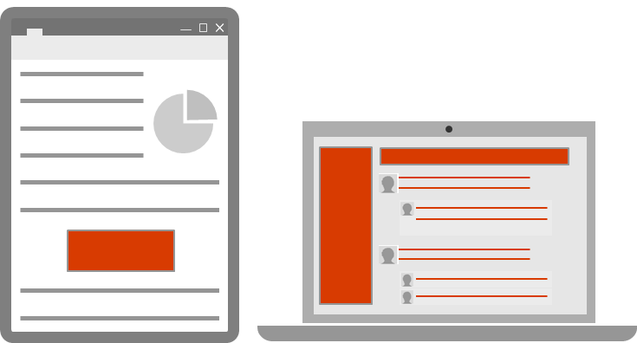
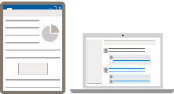
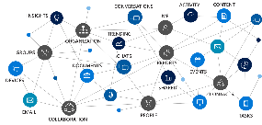
Office 365 Platform
Extensions
STANDALONE WEB AND DEVICE APPS
Documents
PAGES


Conversations
Embedded canvases
Canvases
Microsoft Graph

Slide 10
Microsoft Graph
Unified REST API
Comprehensive developer experience
Integrating data and Intelligence
Exposed by Microsoft Services

Slide 11




SECURITY ALERTS
Microsoft Graph
DEVICES
PARTNER
THREAT INTELLIGENCE
ORGANIZATION
INSIGHTS
ME
ROLES
ADMIN UNITS
CONTENT
ORGANIZATION
REPORTS
GROUPS
USERS
USERS
APPS
CONTACTS
EMAIL
PEOPLE
TEAMS
SITES
DOCUMENTS

Slide 12
Microsoft Graph
Web apps
Native apps
Bots
Background Processes
Microsoft Graph

Slide 13
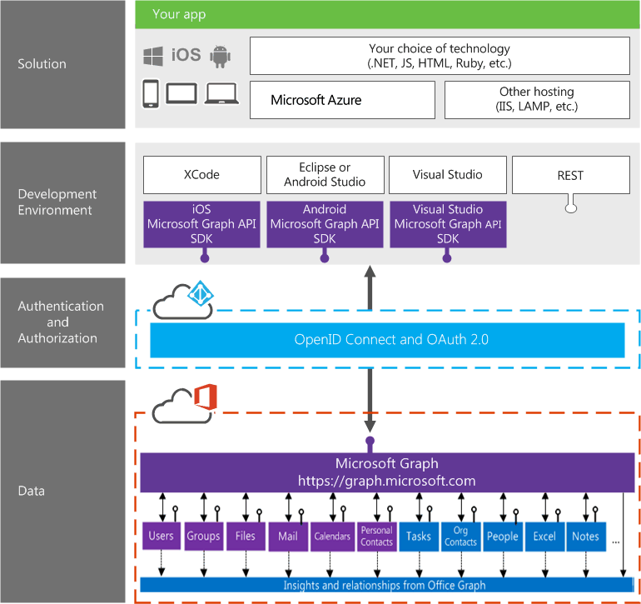
Integration with Office 365

Slide 14
Integration with Office 365

Slide 15
What is the Microsoft Graph?
Before
Before Microsoft Graph we had different APIs for each of the Microsoft Office 365 Services: Files, Mail, Contacts, …
For each endpoint we had a different OAuth token

Slide 16
What is the Microsoft Graph?
Now!!!
Gateway to Office 365
Single endpoint that proxies multiple Microsoft Services
Version endpoints – beta, v1.0
Simplifies token acquisition and management
Eliminates the need to traditional discovery

Slide 17
Single authentication flow for Office 365
Sign users in using OAuth 2 / OpenID Connect.
Device apps, web sites, SPAs and service apps.
Pin apps to Microsoft Office 365 launcher (My apps).

Slide 18
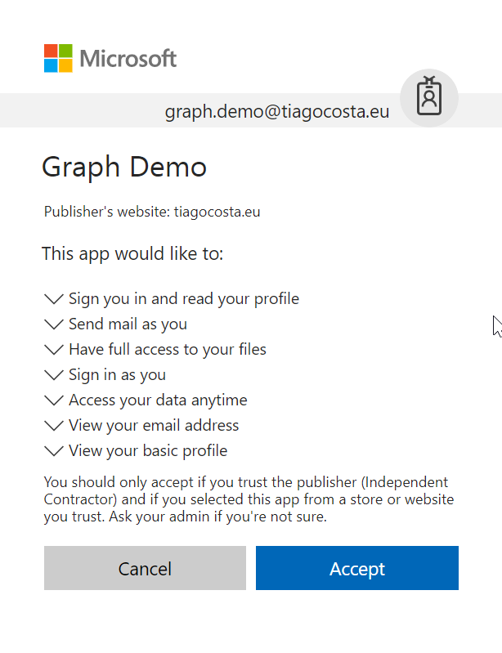
Common consent window
Single auth flow for accessing all O365 services
Admin and end-user consent
Secure protocol
OpenID Connect and OAuth 2.0
No capturing user credentials
Fine-grained access scopes
Long-term access through refresh tokens.

Slide 19
Authentication Option
Azure AD only
Separate auth flow supports Azure AD accounts only
Azure AD and Microsoft Accounts (Consumer)
Converged auth flow supports Azure AD accounts and Microsoft accounts (outlook.com, hotmail.com, etc.)
Many apps want to sign users in from both Microsoft account and Azure AD

Slide 20
Getting Started

Slide 21
Microsoft Graph API
Access user, group and organizational data
One endpoint
One token
All users
Your app
https://graph.microsoft.com
Users
Groups
SharePoint
Outlook
OneNote
Planner
Teams
Excel
Intune
Azure AD
more…

Slide 22
Calling the API
HTTP verbs dictate the request intent: GET | POST | PATCH | PUT | DELETE
Version: /v1.0 or /beta
Resource: /users, /groups, /sites, /drives, /devices, more…
Member from collection: /users/dan
Property: /users/dan/department
Traverse to related resources via navigations: /users/dan/events
Query parameters: /users/dan/events?$top=5
Format results: $select | $orderby
Control results: $filter | $expand
Paging: $top | $skip | $skiptoken
https://graph.microsoft.com
/{version}
/{resource}
/{id}
/{property}
?{query-parameters}

Slide 23
App types and permissions types
App type
Permission type
Who can consent
Effective Permissions
Get access on behalf of users
Get access as a service
Mobile, Web and Single page app
Service and Daemon
Delegated permission (user permission)
Application permission
Users can consent
for their data
Admin can consent
for them or for all users
Only admin can consent
App permissions
User permissions
App permissions
Notes:
https://developer.microsoft.com/en-us/graph/docs/concepts/permissions_reference

Slide 24
Microsoft Graph
Demonstration
Microsoft Graph Explorer
Notes:
https://apps.dev.microsoft.com

Slide 25

Microsoft Graph Data
Active Directory
Users
profile
photo
direct reports
Groups
members
conversations
SharePoint
Sites
Lists
OneDrive
Files
upload
download
copy
versions
Outlook
Mail
messages
folders
send message
Calendar
events
find times
Excel
OneNote
Planner
Contacts
Directory
Beta
Teams
Insights
Project Rome
Devices
Activities
Intune
Reports
…and much more

Slide 26


With Microsoft Graph
GET: /users/dan
{
"displayName": "Dan",
"jobTitle": "PRINCIPAL PM MANAGER"
}
GET: /users/dan/photo/$value
Stream image/jpeg
GET: /users/dan/manager
{"displayName": “Agnieszka", …}
GET: /users/dan/directReports
"value" : [
{"displayName": "Jeff", …},
{"displayName": "Suresh", …},
]
GET: /me/memberOf
"value" : [
{"displayName": "Brits at Microsoft", …},
{"displayName": "Graph PM team", …}
]
Get the user profile
Agnieszka
manager
Groups
memberOf
Dan
directReports
Jeff
Suresh

Slide 27

With Microsoft Graph
GET /me/insights/trending
"value" : [
{"name": "presentation.pptx", …},
{"name": "forecast.xlsx", …}
]
GET /me/drive/recent
"value" : [
{"name": "guidelines.pptx", …},
{"name": "budget.xlsx", …}
]
GET /me/people/?$search="topic: planning"
"value" : [
{"displayName": “Yina", …},
{"displayName": “Dmitry", …},
]
POST /me/findMeetingTimes
{
"attendees": [
{
"type": "required",
"emailAddress": {
"address": "ana@contoso.com"
}
],
"meetingDuration": "2h"
}
Get insights based on activities
Out of office
Trending Documents
Find me the best time to meet Ana
Search people based on topics
People I’m working with
Recent Documents

Slide 28

Microsoft Graph Capabilities
Auth
Credentials
Work/School
Personal
OAuth scopes
Delegated (User)
App
OData
Filter
Order
Pagination
Compliance
Conditional access
National clouds
Query patterns
Web hooks
Delta
Extensions
Batching
SDKs & tools

Slide 29
Extending Microsoft Graph
Open Extensions
GET /me/message/<id>/?$expand=extensions
{
"displayName": “Dan",
"extensions": [
{
"extensionName": "Com.Contoso.Referral",
"companyName": "Wingtip Toys",
"expirationDate": "2017-12-30T11",
"dealValue": 10,000
}
]
}
Schema extensions
POST /schemaExtensions
{
"id": "graph_courses",
"targetTypes": [ "Group" ],
"properties": [
{
"name": "name",
"type": "String"
}…
]
}
GET /groups?$filter=courses/name eq Math101
Add extensions to user, group, mail & more
Customer referral email
Group: Math 101
PMP Certified
Favorite color: blue

Slide 30

With Microsoft Graph
GET/me/mailFolders/{id}/messages/delta
"@odata.deltalink":"me/mailfolders('AA')/messages/delta?$deltatoken=BB",
"value" : […]
POST /subscriptions
{
"changeType": "created,updated",
"notificationUrl": "https://app.net/callback",
"resource": "/me/mailfolders('AA')/messages",
}
GET/me/mailFolders/{id}/messages/delta ?$deltatoken=BB"
"value" : […]
Get notifications & track changes
Edited a file
Scheduled a new meeting
Got a new hire
Added a new member to a group
Got high important email

Slide 31
With Microsoft Graph
POST /$batch
{
"requests": [{
"id": "1",
"url": "/me/drive/root/children",
"method": "POST",
"body": {
"name": "folder1",
"folder": {}
},
"headers": {
"content-type": "application/json"
}
}, {
"id": "2",
"url": "/me/drive/root/children/folder1",
"method": "GET",
"dependsOn": ["1"]
}, {
"id": "3",
"method": "GET",
"url": "/me/planner/tasks"
}, {
"id": "4",
"method": "GET",
"url": "/groups/{id}/events"
}
]
}
Use $batch to combine multiple requests in one call
Documents
Calendar
Sites
Tasks
Email
Meetings
Contacts

Slide 32












SDKs, samples and tooling
GA*
GA
GA
GA
PREVIEW
ASP.NET MVC
JavaScript
Angular
PHP
Python
GA*
GA*
GA*
PREVIEW
PREVIEW
Xamarin
UWP
Android
iOS
Ruby
UPDATED
PREVIEW
VS integration
Bindings

Slide 33
Microsoft Graph SDK
Current version is 1.7.0
https://www.nuget.org/packages/Microsoft.Graph
Always lagging behind the Graph REST API
Release Notes
December 2017 Release Summary (version 1.7.0)
New features
Include symbols in the Nuget package

Slide 34
Microsoft Graph SDK - Install
To install Microsoft.Graph, run the following command in the Package Manager Console:
Install-Package Microsoft.Graph

Slide 35
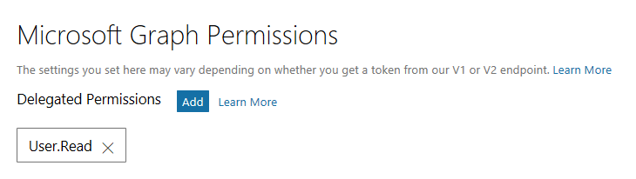
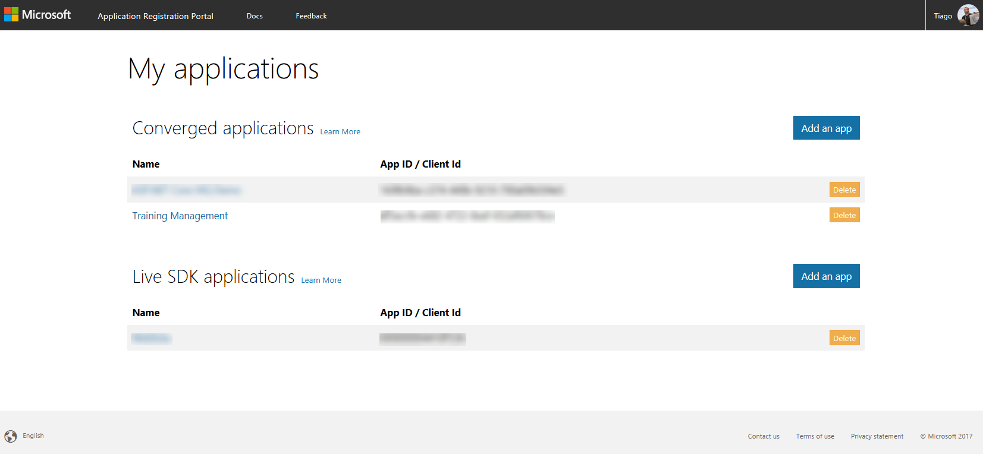
Application Registration Portal
Portal to register your apps
https://apps.dev.microsoft.com

Slide 36
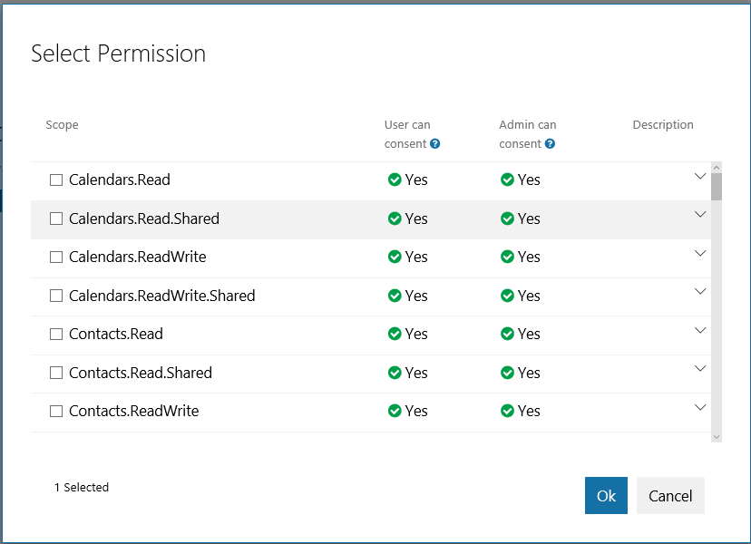
Microsoft Graph Permissions
When registering an app we need to select the needed permission that our app we have via Microsoft Graph.

Slide 37
Microsoft Graph
Demonstration
Register a new Application
Notes:
https://apps.dev.microsoft.com

Slide 38
Microsoft Graph
Demonstration
ASP.NET Application using the Microsoft Graph via SDK
Notes:
https://apps.dev.microsoft.com

Slide 39
Microsoft Graph
Demonstration
Using Azure functions to process a new hire
Notes:
https://apps.dev.microsoft.com

Slide 40
Application Scenarios

Slide 41

Applications you can build
Intelligent workflows & processes
Group management & compliance
B2B relationships
Secure transactions using conditional access
Smart meetings

Slide 42
Provision workflows – user onboarding
New hire created
Set profile
Assign devices
Provision mobile devices
Authorize access
Assign to groups
Assign licenses
Assign to roles
Set manager
POST /users
POST /groups/{id}/members/$ref
POST /users/{id}/assignLicense
POST /groups/{id}/directoryRoles/$ref
POST /users/{id}/manager/$ref

Slide 43
Provision workflows – user onboarding
Department update
Change dept.
Re-authorize
Remove from groups
Work in progress?
Working on?
Tasks
Set new manager
Add to groups/roles
Notify manager
Current manager
/users/delta?$select=department
Track department changes
PATCH /users/{id}
DELETE /groups/{id}/members/$ref
/users/{id}/insights/trending
/users/{id}/manager
/users/{id}/tasks
POST /groups/{id}/members/$ref
POST /users/{id}/manager/$ref
POST
/directoryRoles/{id}/members/$ref
POST /users/{id}/sendMail

Slide 44
Automated Support Ticket Assignment
Set up Group
Create Schema Extension
Find an Engineer
Search for Group based on Support Topic
Perform Smart Routing
Check for OOF
Add Members
Create Group tagged w/ Support Topic
Find Engineer
Find an Expert to Help
POST /schemaExtension
GET /users/{id|userPrincipalName}/mailboxSettings/automaticRepliesSetting
GET https://graph.microsoft.com/v1.0/groups?$filter=support_topic/name eq ‘Developer Tools’
POST /groups
GET https://graph.microsoft.com/v1.0/me/people/?$search="topic:Authentication"
POST /groups/{id}/
members/$ref
GET /groups/{id}/
members

Slide 45
Resources

Slide 46
Resources
Documentation, samples and more
https://graph.microsoft.com
https://github.com/microsoftgraph
Stack Overflow
[MicrosoftGraph]
Twitter
#MicrosoftGraph

Slide 47
Getting Started
Getting Started with APIs
https://developer.microsoft.com/en-us/graph/quick-start
Microsoft Graph API Code Samples
https://dev.office.com/code-samples
Microsoft Graph API documentation
https://developer.microsoft.com/en-us/graph/docs

Slide 48
Developer Program
1 YEAR FREE
E-mail Newsletters
Free Developer Subscription
Free Training
Free Tools
Webinars
http://dev.office.com/devprogram

Slide 49
Labs

Slide 50
Labs
https://github.com/OfficeDev/TrainingContent/tree/master/Graph

Slide 51
Closing
Thanks for allowing me to boring you all

Slide 52
My name is Tiago Costa
And this is how you build Intelligent Application with the Microsoft Graph.
tiago.costa@outlook.com
www.tiagocosta.eu

